Slide 1
API
API (application programming interface) is a set of rules and mechanisms by which one application or component interacts with the others. The API makes it easier for different software systems to interact and exchange information without needing to understand each other's internal workings.

Slide 2
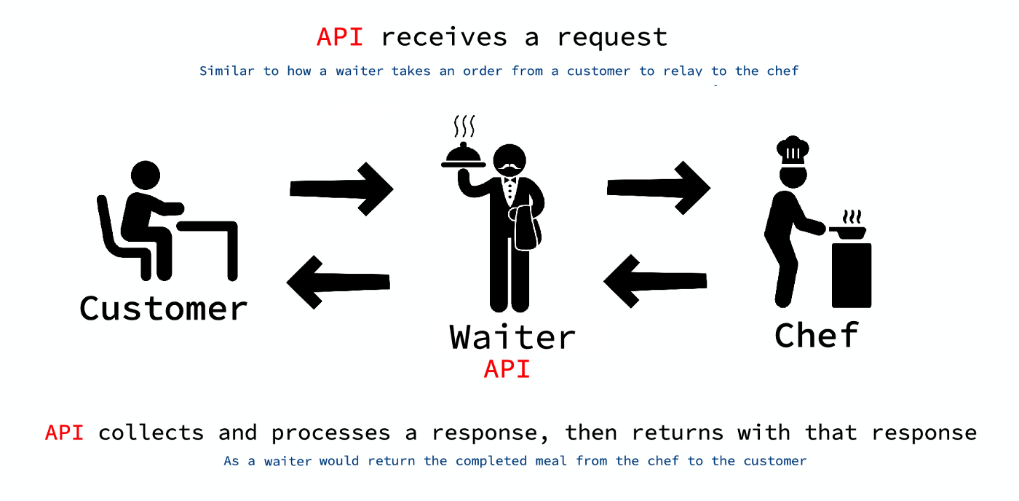
API in real life

Slide 3
You (the customer): You have a request, like ordering food (e.g., a pizza).
The Waiter (the API): You tell the waiter (the API) what you want, but you don't directly interact with the kitchen (the backend system).
The waiter takes your order and communicates it to the kitchen.
The Kitchen (the server/system): The kitchen prepares your food (the data or service you requested).
The Waiter (the API): Once the food (data) is ready, the waiter brings it back to you.

Slide 4
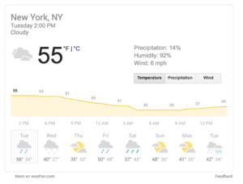
API in real life
Weather data on Google Search

Slide 5
A Weather API is a service that provides weather information (such as temperature, humidity, or forecast) from a server to your application or website.
It's like asking a weather station for current weather data.
Step 1: Your App Makes a Request (HTTP GET Request)
You (or your app) want to know the weather in London.
You send a request to the Weather API server (like Google’s weather service) by typing an HTTP GET request in the following format:
GET http://api.weather.com/v1/current?city=London&apikey=your_api_key
GET means you're asking the server for information.
city=London is your request to get the weather for London.
apikey=your_api_key is a special key (you get this after signing up with the API provider) that identifies who is making the request.

Slide 6
Step 2: Server Processes the Request
The server (weather provider) receives your request and knows that you want the current weather for London.
It looks up the weather data in its database or external sources (like satellites or sensors) and prepares the information to send back.
Step 3: Server Sends the Data Back (HTTP Response)
The server sends back the weather data in JSON format (a simple, readable format).
The response might look like this:
{
"temperature": "15°C",
"humidity": "80%",
"forecast": "Cloudy"
}
This is the data your app wanted: temperature, humidity, and the weather forecast for London.
Step 4: Your App Displays the Weather Data
Your app takes the weather data (from the JSON response) and displays it to the user, like showing "15°C" on the screen.

Slide 7
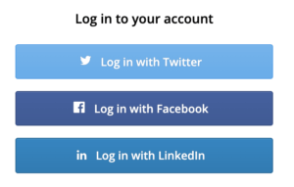
API in real life
Log-in Using Facebook/Twitter/Google/Github
Whenever you try to access any new application for the first time e.g. https://zoom.us/signin
It asks you to authenticate yourself either by creating your sign up into zoom’s application or use facebook or google etc. So that means we are using facebook or google apis to authenticate outselves. What zoom application does is it integrates these apis (facebook and google ) into their own application.

Slide 8
When you log in using Facebook/Twitter/Google/GitHub, the app sends a REST API request to the service (like Google).
The service sends a token to the app after you log in and grant permission.
The app uses that token to make another REST API request to get your user information (like your email, name).
The app uses this data to log you in without needing your password.
These platforms have published their APIs (like Google API, Facebook API, etc.) so developers can integrate login functionality into their apps easily.

Slide 9
Spotify,Uber,Pinterest,GitHub,Dropbox, Medium (Blogging Platform) these apps use social media login options like Facebook, Google, Twitter, or GitHub to simplify the sign-up/login process, making it easier and faster for users to get started without creating a new account or remembering another password.

Slide 10
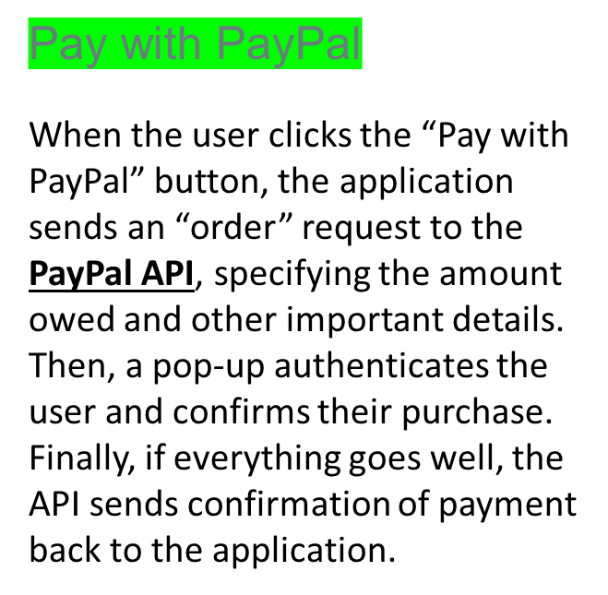
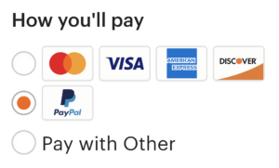
API in real life
Most online stores offer Paypal and other payment methods, utilizing API connections to these services.

Slide 11
1. User Chooses PayPal: You pick PayPal as the payment option on the store.
2. Store Sends Payment Setup: The store sends a request to PayPal’s REST API to set up the payment.
3. PayPal Provides Approval URL: PayPal responds with a URL for you to approve the payment.
4. You Approve the Payment: You log in to PayPal and approve the payment.
5. Store Verifies the Payment: The store sends a request to PayPal to verify if the payment was successful.
6. PayPal Responds: PayPal returns the payment status (approved or declined).
7. Store Completes the Order: The store processes the payment and ships your items (if approved).
Why is PayPal API a REST API?
because it
- Uses HTTP methods: PayPal’s API uses standard HTTP methods like GET, POST, and GET for communication.
- JSON Data Format: The requests and responses are typically in JSON format, making it easy to read and process.
- Stateless: Each request to PayPal is independent; no session information is stored between requests. The app always sends the necessary data in each API call.
- URL-based Resources: Each API call interacts with a specific resource (e.g., a payment, a transaction), which is identified by a URL.

Slide 12
PayPal REST API enables online stores to handle payments by sending API requests to PayPal to create payments, verify transactions, and complete purchases. Each step involves making standard RESTful API requests to PayPal’s servers and receiving responses that the store uses to complete the transaction.

Slide 13
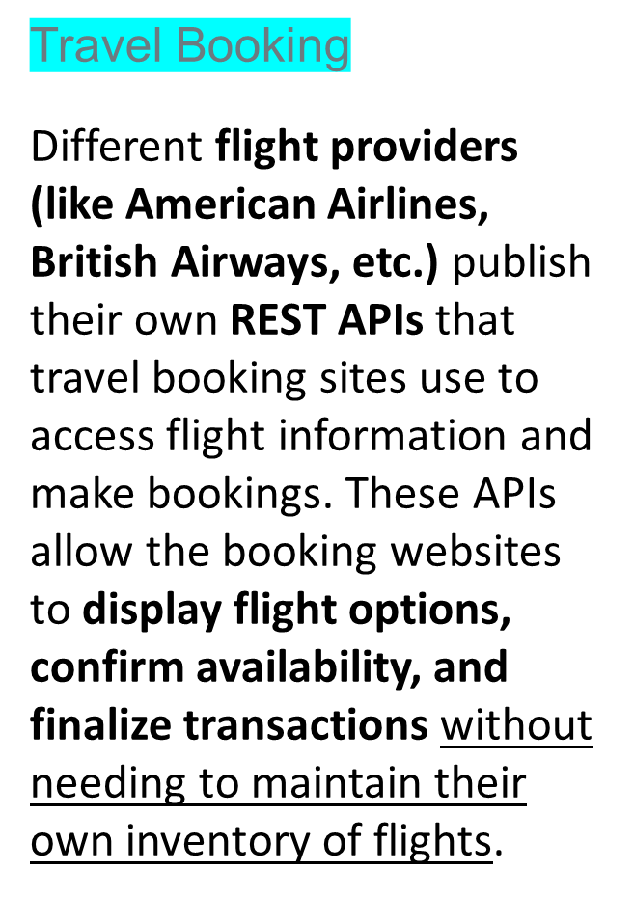
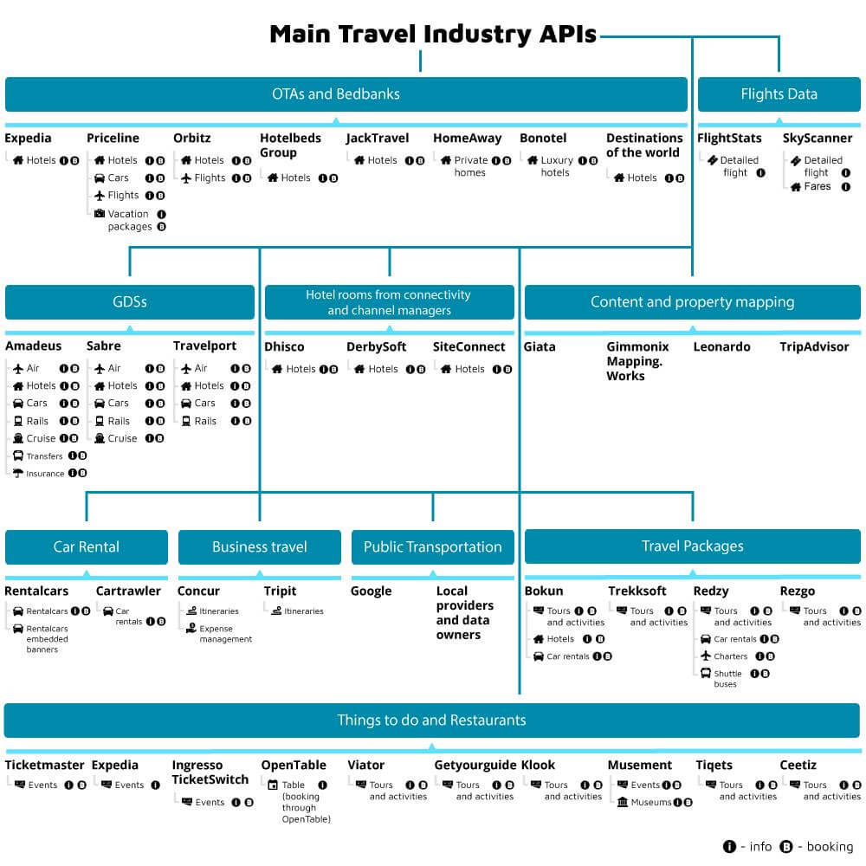
API in real life

Slide 14
User enters search details on the travel website (departure city, destination, dates, etc.).
The website sends a REST API request to third-party flight providers to get available flights.
Flight provider sends back available flights with details like prices and times.
The website displays the flight options to the user.
  User selects a flight and enters personal and payment details.
The website sends a REST API request to confirm the booking with the flight provider.
Flight provider confirms the booking, returning a success message and booking reference.
The website displays confirmation to the user and finalizes the payment.

Slide 15
Why is REST API Used here ?
HTTP Methods: The travel website uses GET (to search flights) and POST (to book flights) methods to interact with flight provider APIs.
Data Format: Data is typically exchanged in JSON format, which is easy to read and parse for both the website and the flight providers.
Stateless: Each API request is independent, and the website doesn't have to remember the user's previous interactions, making each booking request straightforward.
URLs Represent Resources: The APIs are structured around resources, such as flights and bookings, and each resource is accessible via a unique URL.

Slide 16
REST API
In the web services terms, REpresentational State Transfer (REST) is a stateless client-server architecture in which the web services are viewed as resources and can be identified by their URIs. Web services client uses that URI to access the resource.

Slide 17
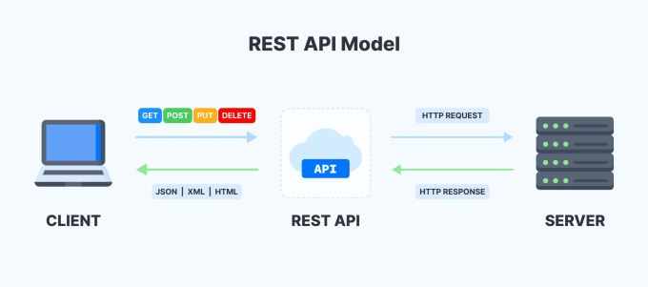
REST API

Slide 18
Meaning of Representational State Transfer
REST stands for Representational State Transfer, a term coined by Roy Fielding in 2000. It is an architecture style for designing loosely coupled applications over the network, that is often used in the development of web services.
Meaning of REST:- Whatever the data is there on server is called as resource. While sending this resource from server to client , resource is not sent directly, its representation is sent. The resource is still there on the server. That’s why it is known as “Representational”. “state” means state of the resource which is on the server at a specific time, e.g. current temperature is 5 and tha can be changed in future. “Transfer” means resource is transferring from server to client.

Slide 19
Advantages of RESTful Web Services
Fast: RESTful Web Services are fast because there is no strict specification like SOAP. It consumes less bandwidth and resource.
Language and Platform independent: RESTful web services can be written in any programming language and executed in any platform.
Permits different data format: RESTful web service permits different data format such as Plain Text, HTML, XML and JSON.

Slide 20
Stateless meaning in REST
As per the REST architecture , the server doesn’t store any state about the client session on the server side. Stateless means that every HTTP request happens in complete isolation.

Slide 21
HTTP methods used in REST
GET: Retrieves one or more resources identified by the request URI and it can cache the information receive.
POST: Create a resource from the submission of a request and response is not cacheable in this case.
PUT: Update an existing resource on the server specified by the request URI.
DELETE: Delete an existing resource on the server specified by the request URI.
GET, PUT, DELETE methods (except “Post”) are also known as Idempotent (safe) methods. Applying an operation once or applying it multiple times has the same effect.

Slide 22
API Endpoint
API endpoint is a location from applications can access the resource. It’s a point where two piece of softwares can communicate to each other. In REST API we follow some standard structure for an API endpoint.
<Protocol>://<Domain>/api/<Resource Path>
Here “Protocol” can be http, https etc.
Domain can be a different level of domain e.g. domain , subdomain etc.
api is optional but always used as a convention.
Resource path is the actual resource which client can access ,update, delete etc.

